Slide 1


Year 6 Curriculum Evening 2026
Mrs Burke and Mrs Eddie

Slide 2
Values
Our values are at the heart of Holy Family. They support our school’s Catholic mission and underpin all we do. Values are taught through the curriculum, through our behaviours and in assemblies. Our values have become our common language. We talk about our values each day and the whole school community demonstrate the values through their behaviours in their interactions and during lessons. Our values help the children to achieve well and also become well rounded individuals so that when they move to their next phase of learning they are ready to embrace the future. ​

Slide 3

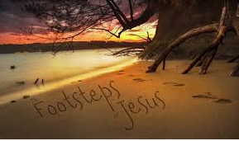
““The children and youth of our world are the ones Jesus wanted to come to him.”
Pope Leo XIV, February 2026” ​

Slide 4
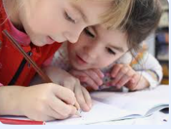
Writing
Quality Text based writing projects. ​
Linked to Cross Curricular subjects where possible. ​
Opportunities for extended writing, editing and redrafting.
Year 6
​
Autumn | Spring | Summer
War Horse – Michael Murpurgo Character description Pamphlet Diary entry Why did the war start? Non chronological report Diary entry Walter Tull-Black Poppies Biography In Flanders Field Poetry based on WW1 Suffragettes: The Battle of Equity - David Roberts Formal speech Letters Diary entry Newspaper report The Christmas Truce – Sainsbury’s letter | The Hidden Forest by Jeannie Baker research notes non-chronological report balanced discussion letter to a character The Explorer by Katherine Rundell Setting description Survival guide The Explorer by Katherine Rundell Character description Diary entries Non chronological report Diary Book review | Macbeth (a number of different versions Macbeth by William Shakespeare Mr. William Shakespeare’s plays by Marcia Williams Shakespeare Stories by Leon Garfield) A diary entry in role Debate discussion text police reports journalistic article a review.

Slide 5

Reading
Expectation in Year 6 is that we read 3 times a week.
At home…​
happy for children to sign their own reading records
Summarising​
Sequencing​
Predicting​
Explain​
Comprehension is key! ​
Independent re-reading​

Slide 6
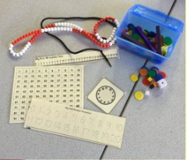
Maths
White Rose​ Hub
Mild, Medium, Spicy and/or Hot challenges ​
Mastery activities – these are the EXTRA or the blue book​
TT Rockstars​

Slide 7


Maths
ARITHMETIC
Place Value​
Addition, Subtraction, Multiplication and Division​
Fractions –
Converting Units
Ratio
Algebra
Decimal
Fractions, Decimals and Percentages
Area, perimeter and volume
Statisitcs
Shape
Position and Direction

Slide 8
PE
PE will be on a Monday and Wednesday.
This half-term the focus will be…
Gymnastics
Tag Rugby

Slide 9


RE
​The Vine and the Branches​
This year we follow the RE programme entitled ‘The Vine and the Branches’.
Each half term will follow a new topic; Creation and Covenant, Prophecy and Promise, Galilee to Jerusalem, From Desert to Garden, To the Ends of the Earth, Dialogue and Encounter.​
Teacher led and Pupil Led prayer and liturgy​
‘Together We Pray’

Slide 10

Science
​Animals Including Humans Circulatory System Diet/exercise Drugs Living Things and Their Habitats Classification transportation of nutrients: plants & animals the Linnaeus system | Evolution and Inheritance Changes over time: fossils Offspring Adaptation Light How light travels Light form sources to eyes Shadows Electricity Symbols and diagrams function of components Voltage and its impact

Slide 11


History and Geography
​History
Have we Learnt from Past Wars?
FOCUS WW1 Develop children’s knowledge of the causes and effects of the first World War: significant battles, people and the impact of this devastating war
Then move onto WW2
How do we know about the Peterloo Massacre?
Chren are Peterloo detectives as they use their historical enquiry skills to investigate a range of evidence from Manchester University collections including maps, newspaper articles, posters and etchings to interpret the events that unfolded at St. Peter’s Field in Manchester
Geography
Why is part of the world in darkness when the rest is in daylight?
Identify position and significance of latitude, longitude, Equator, Northern Hemisphere, Southern Hemisphere, Tropics of cancer and Capricorn, Arctic and Antarctic circle, 8 points of a compass 4 and 6 figure Grid references
What is the climate like in South America?
Locational geography: Locate South America concentrating on environmental regions, key physical and key human characteristics, countries and major cities

Slide 12

Computing
Coding
Graphing
Data Detectives
Blogging
Spreadsheets
Networks
Introduction to Python

Slide 13


Jigsaw
​
We follow a P.S.H.E scheme called ‘Jigsaw’. This scheme is used throughout the school and deals with personal, social and health education topic that are appropriate for each year group. ​
Our year begins with….’Being me in my world’ and continues with ‘Dreams & Goals’, ‘Celebrating Differences’, ‘Healthy me’ and ‘Changing me’. ​

Slide 14


RSE

Slide 15
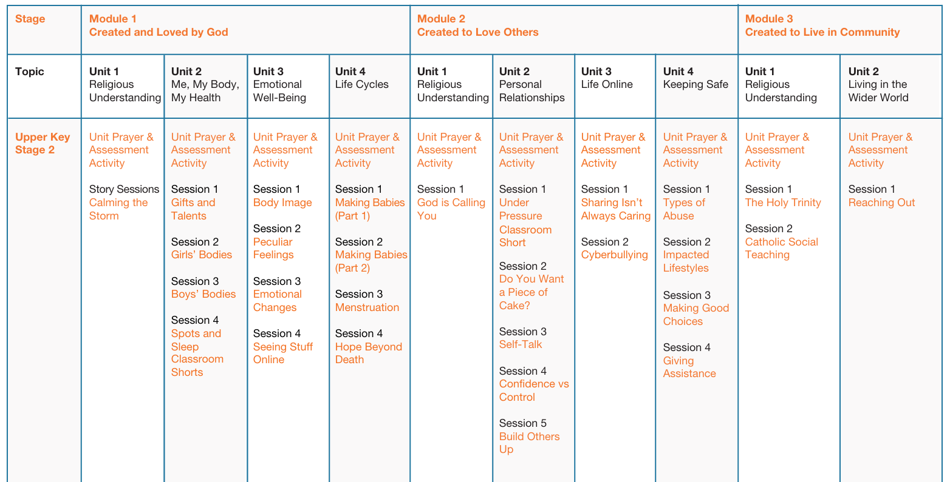

Slide 16
Art/Design Technology
Art | Design Technology
3D sculpture Collage Printing | Food Textiles Electrical systems

Slide 17
Music
Exploring lyrics and melody Exploring rounds 2 Exploring sound sources/orchestra Exploring pulse and rhythm/dictation Exploring pitch/notating triads Performing together

Slide 18
SATS
Week beginning 10th May
Monday –
Punctuation and Grammar Paper (45 minutes)
Spelling (20 spellings)
Tuesday
Reading Paper (1 Hour)
Wednesday
Maths Paper 1 – Arithmetic (30 minutes)
Maths Paper 2 – Reasoning (40 minutes)
Thursday
Maths Paper 3 – Reasoning (40 minutes)

Slide 19

Wellbeing
Jigsaw PSHE scheme​
Pastoral care/ workshops​
Zones of Regulation’​
Mindfulness activities in the classroom
World Mental Health Day etc​
Meditation, yoga etc​

Slide 20

Home Learning
We send out Home Learning on a Friday – this is now into Homework books – these need to be returned as on a Friday we go through the homework together.
We will alternate between Maths and English
Spellings will also be sent home each week – they will also be put onto Spelling Shed.
Spellings will be tested on a Friday.

Slide 21

Behavioural Expectations
We expected all children to follow this:-
Follow the school values
Show forgiveness
Have a positive growth mindset
Ask for support when needed
Work as a team

Slide 22
Punctuality and Attendance
PUNCTUALITY: ​
Please ensure your child arrives at their classroom door before the morning bell, which is 8.45 The door opens at 8.35. Learning starts at 8.45am
This facilitates a calm and prompt start to the day.​
​
ATTENDANCE:​
We want our children to have excellent attendance and achieve well. Please note that we do not authorise holidays in term time. ​
Please refer to our term dates before booking a holiday to ensure it is booked within the half term holiday. ​
Please also note that we do not permit a child to leave school early to travel. As part of our safeguarding procedures, if your child is too poorly to attend school, please notify the school office by phoning or emailing to report the reason for absence on
Please note that all routine, non-urgent medical appointments such as the dentist and opticians should be made outside of the school day​

Slide 23
And Finally…
f you have any questions, queries or worries, please come and see us, we want to help!​
If you are unable to speak to any of us at the door, please send a ‘direct message’ on Seesaw.

Slide 24
General Reminders
Doors open at 8.35am
We promote high standards of presentation in school and at home.​.​
Please ensure all belongings are labelled (water bottles, coats, uniform).​
Ensure your child wears correct uniform and has a coat in school every day.​
At least 95% attendance is expected from all children. (Equal to missing 9 days of school)​
Where possible please try and keep appointments to outside school hours.​
Try and complete home learning – as this is good practice for High School

